Slide 1
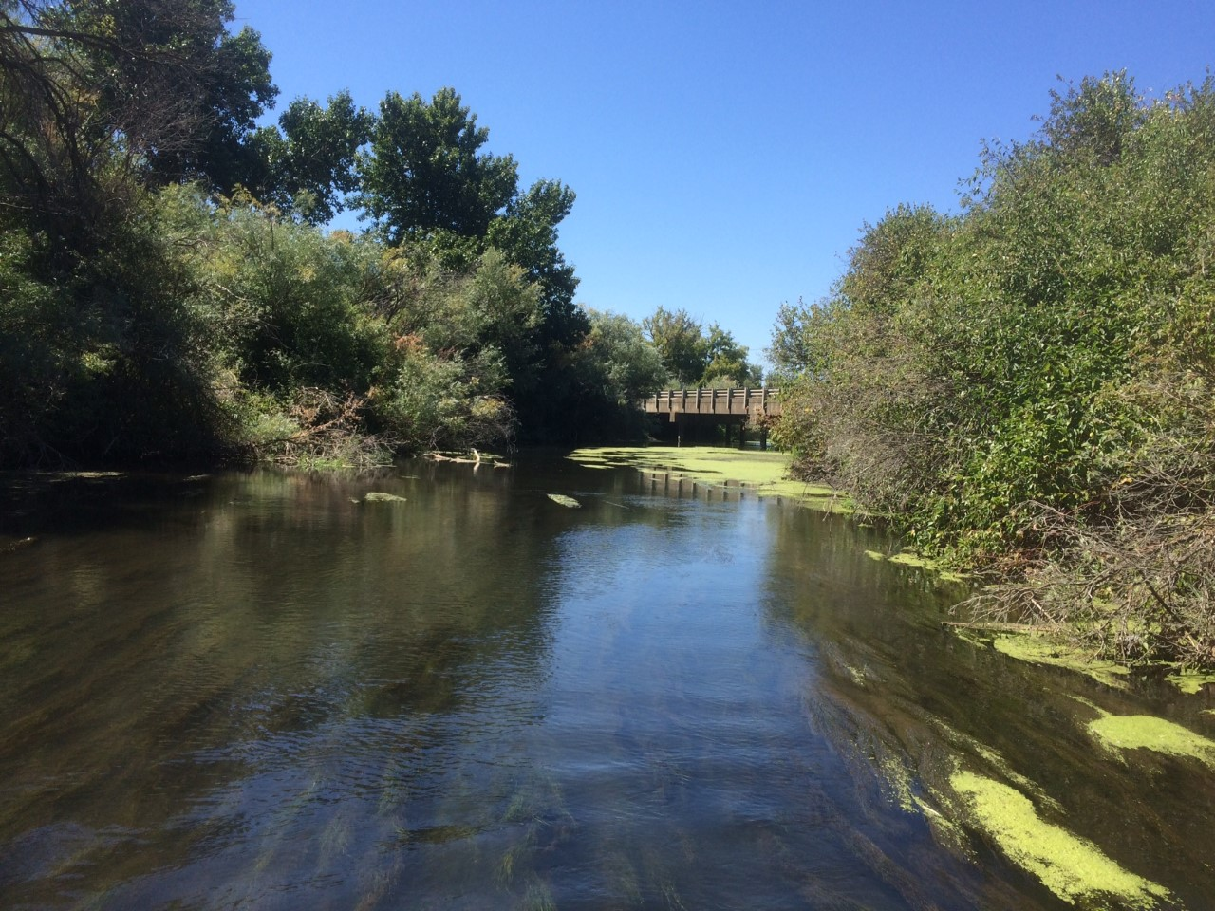



The influence of irrigation flows on microbial and algal nutrient limitation
Sarah S. Roley (@ssroley)
Clay Arango
Alex Alexiades

Slide 2
Streams = opportunity for N and P mitigation
Streams are biologically active!
Assimilatory uptake often major pathway for N removal
What limits microbial and algal production in irrigated agricultural systems?

Slide 3
Irrigated Agriculture
USGS 2004

Slide 4
Irrigation season
River → Field → River
Seasonal differences in hydrology, potential differences in [nutrient]
Non-Irrigation season
Groundwater → River

Slide 5
Irrigation and seasonality
Demand: ↑ with sun, temp
Supply: ↑ with irrigation, may vary with nutrient
Covino et al. 2018

Slide 6
What limits microbial and algal production in irrigated systems?
Assimilatory uptake often major pathway for N removal
How does this change in irrigation vs. non-irrigation season?

Slide 7
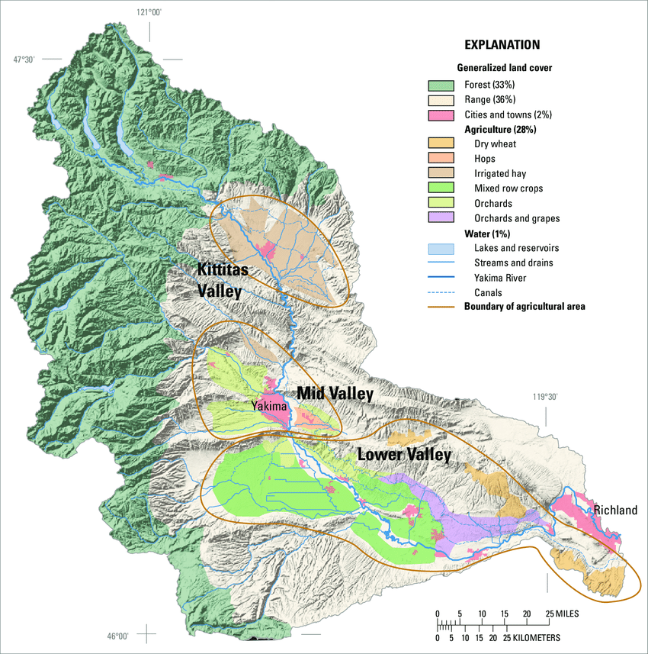
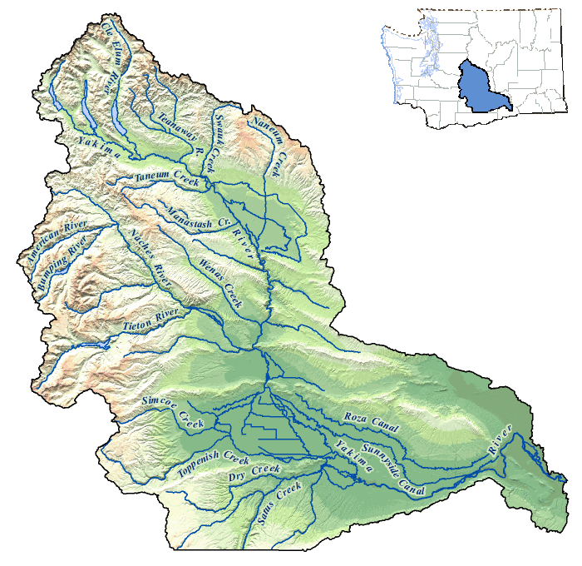
Study sites – tributaries of the Yakima River
irrigated hay
study sites
orchards & hops
orchards & grapes
mixed row crops
dry wheat

Slide 8
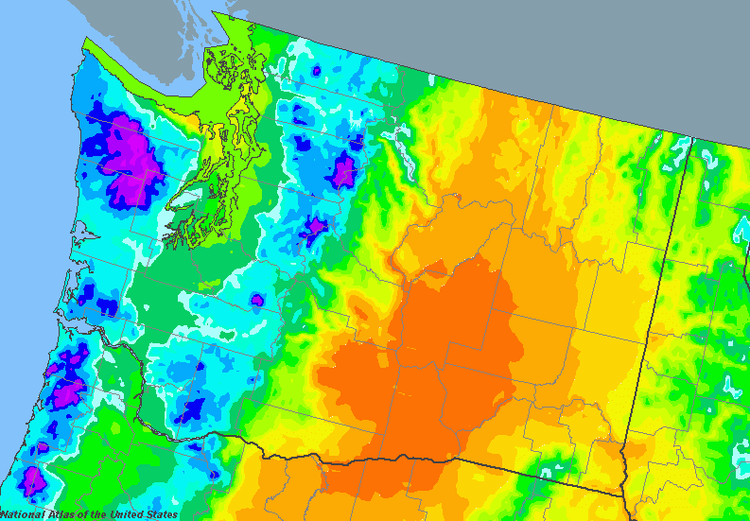
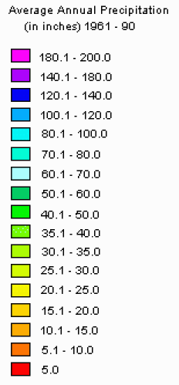

Slide 9
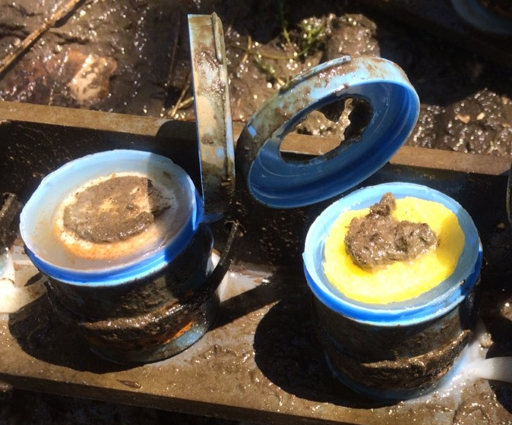
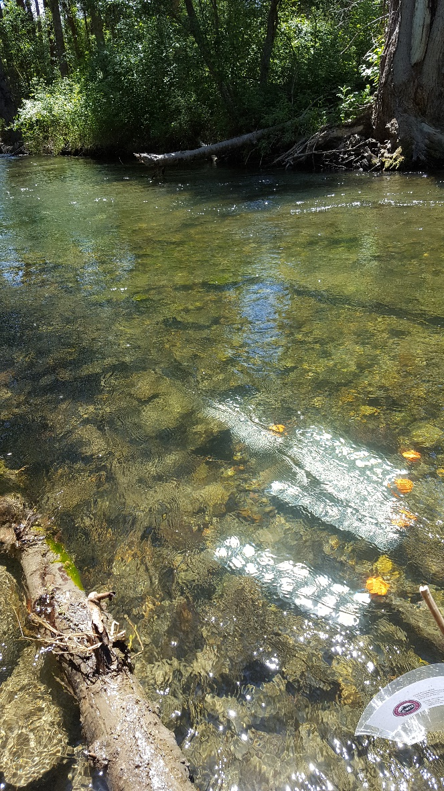
Methods – Nutrient-Diffusing Substrates (NDS)
Glass – for primary producers
Cellulose – for heterotrophs
Agar + nutrients (N, P, Si, or combination)

Slide 10
Methods – Interpretation of NDS Data
Compare production to the controls

Slide 11
Hypotheses

Slide 12
[Nitrogen] ↑ downstream, with irrigation
Irrigation
Non-irrigation
NH₄⁺
NO₃⁻
No data
upstream → downstream

Slide 13
[Nitrogen] ↑ downstream, with irrigation

Slide 14
[DOC] varies with season, location
Non-irrigation
Irrigation
upstream → downstream

Slide 15
CR limitation during irrigation season only
Irrigation
Non-irrigation
N
P
Si
NP
NSi
PSi
NPSi
Reecer
Wenas
Satus
Reecer
Wenas
Satus
Ahtanum
Toppenish
Ahtanum
Toppenish
upstream → downstream
Co-limitation most common
Notes:
No nutrient limitation during fall – temp likely limiting
Fall: if influx of nutrients in the fall, uptake unlikely. Relevant: nutrients coming in through groundwater (slow pathways)
Irrigation season: site variation
common: co-limitation of NPSi
If additional N and P enter the system, will also need Si for biota to respond
Wenas: capacity to take up more N
Toppenish: can take up more N, but only if Si present

Slide 16
GPP limitation during irrigation season only
Irrigation
Non-irrigation
N
P
Si
NP
NSi
PSi
NPSi
Reecer
Wenas
Satus
Reecer
Wenas
Satus
Ahtanum
Toppenish
Ahtanum
Toppenish
upstream → downstream
Notes:
again, no limitation in the fall = limited capacity for taking up additional N and P
Likely limited by light and temp
Summer: site variation. Reecer not responding to inputs, probably also light limited (shaded stream)
Wenas can respond to P, but Toppenish responded primarily to Si
Ahtnaum and Satus: bit of a mystery – not particularly shaded, but doesn’t respond even to the combination of nutrients. Something else limiting?
Overall: some sites have the ability to take up additional nutrients, but others do not

Slide 17
Conclusions/Hypotheses
↑ [N] coincident with ↑ potential uptake
Irrigation season: site variation; some potential for ↑ N & P removal
Non-irrigation season: light and temperature likely limit uptake

Slide 18
GPP consistent through time

Slide 19
CR consistent through time

Slide 20
Reecer
Wenas
Ahtanum
Toppenish
Satus
Irrigation

Slide 21
Reecer
Wenas
Ahtanum
Toppenish
Satus
Non-irrigation

Slide 22
Reecer
Wenas
Ahtanum
Toppenish
Satus
Irrigation

Slide 23
Reecer
Wenas
Ahtanum
Toppenish
Satus
Non-irrigation

Slide 24
Reecer
Ahtanum
Wenas
Toppenish
Satus
Irrigation

Slide 25
Reecer
Ahtanum
Wenas
Satus
Toppenish
Non-irrigation

Slide 26
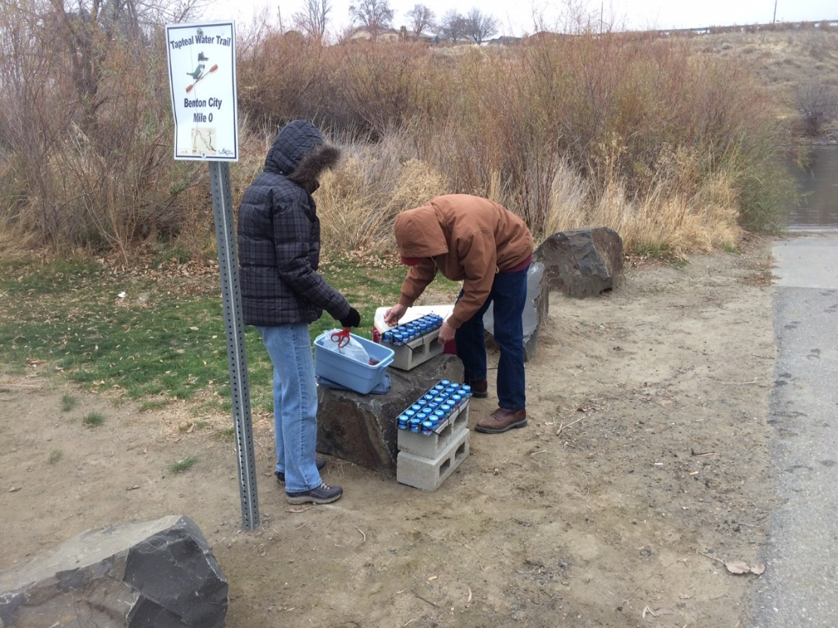
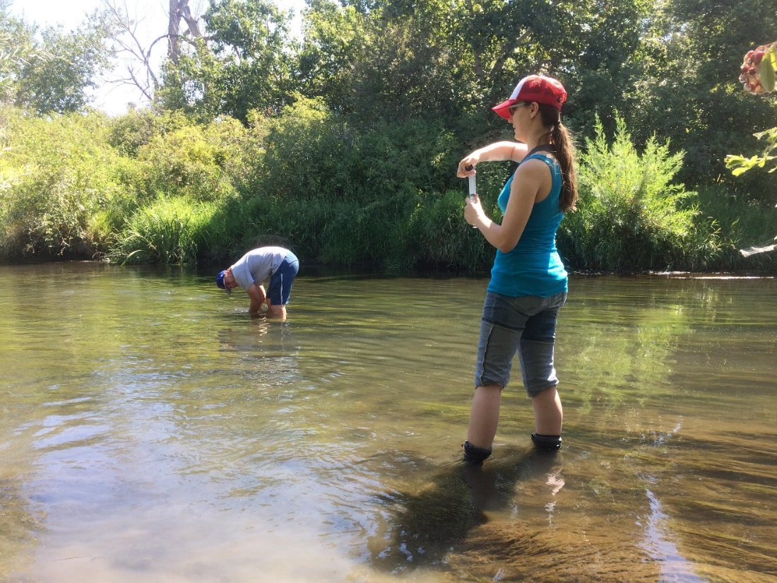
Acknowledgements
contact: sarah.roley@wsu.edu, @ssroley
Site access: Yakama Nation
Field and lab help: Rhenton Brimberry, Cassandra Elkins, Alifya Saify, Allison Staten, Noelle Scofield, Allyn Roley, Susan Roley

